Slide 1
scRNA seq data analysing tools
Niels Vanneste
Notes:
Welcome to the comparison of tools for single cell rna seq data here used for differential expression

Slide 2
Summary
Info
Data
DESeq2
EdgeR
Monocle2
Comparison

Slide 3
Bulk RNA versus single-cell RNA
Partial info molecular state
Average expression
Expression profile individual cells
Gene clustering analysis
Notes:
First of all why is single cell so interesting? In comparison to bulk rna there are some differences. You have in the bulk rna sequencing only partial info about the molecular state of your researched tissue. And when it comes down to DE you’ll only get an average expression because it is taken from a group of cells a ‘bulk’. As in single cell RNA we work with a single cell as the name suggests and eventually only an expression profile for individual cells is available. You can know where the cell is in his cycle. Through gene clustering analysis for individual cells some subpopulations within a heterogeneous cell population can become available for studying

Slide 4
Summary
Info
Data
DESeq2
EdgeR
Monocle2
Comparison

Slide 5
Public dataset
scRNA seq
SMART-SEQ2
Homo Sapiens
Single-Cell Transcriptome Profiling of Human Pancreatic Islets in Health and Type 2 Diabetes
Segerstolpe et al.
Notes:
To make the comparison i needed some single cell rna seq data. This data came from … written by segerstolpe

Slide 6
Data
2 conditions
Healthy
Type 2 diabetes
5 - 6 fastq files per condition
2-10 million reads
4 single cell groups
Notes:
From this dataset i have files with 2 conditions either they were normal or they were T2D diagnosed. These were human sequencing raw data. From this dataset i have taken from this dataset 5-6 fastq files per condition. These fastq files have reads between 2-10 million. In articles they describe that that amount is enough

Slide 7
Workflow
Mapping
STAR
Quantification
HTSeq-Count
Differential expression analysis
DESeq2
EdgeR
Monocle2
Notes:
The workflow i used was simple first a mapping to the human genome with STAR then after the reads are aligned i use HTSeq-Count with the identifier on and stranded off to count the reads. After this data i used the different DE tools to analyze the data.

Slide 8
Differential expression tools
Bioconductor packages:
DESeq2
EdgeR
Monocle2
Notes:
For the DE tools. They all came from bioconductor. These are all R scripts. DESeq2 and EdgeR are familiar here since they were already used. Monocle2 is a new tool that is discussed in multiple scRNA analyzing papers.

Slide 9
Summary
Info
Data
DESeq2
EdgeR
Monocle2
Comparison

Slide 10
DESeq2
Bulk RNA-seq
R version 3.3.1
Probability distribution of read counts per feature
Negative binomial
Notes:
DESeq2 is already in use with bulk RNA seq. This algorithm might only be viable for using it in bulk RNA seq, but still testing it on scRNA seq might be usefull for some insights.
This packages needs R version 3.3.1 and it uses an negative binomial expression profile.

Slide 11
DESeq2
Normalized
Suboptimal clustering
Poor differentiation of samples by condition
Notes:
DESeq2 was used to cluster some off the data and after analysis this is the graph it gave. This isn’t optimal since you can’t differentiate the groups from each other easily. They all seem to cluster together. De grafiel is bekmen door de countsets te gebruiken en te log tranformeren voordat deze in een grafiek worden gezet.

Slide 12
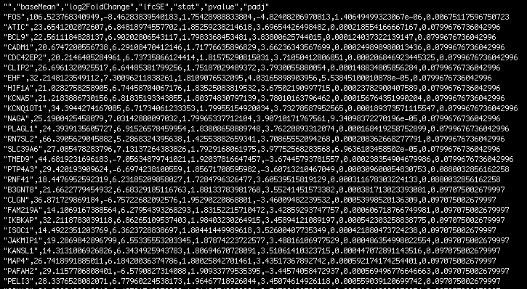
DESeq2
Gene name
BaseMean
Log Fold change
P-value
P-adjusted
Less stringent
Notes:
These are the DE results you get after the script is done. The output gives what is most important to us the log fold change, pvalue and p adjusted value. These were the highest resultst in one of the datasets.
DESeq has a tendency to report some genes even though only one sample gave reads of taht particular gene. Just because it is made for bulk RNA

Slide 13
Summary
Info
Data
DESeq2
EdgeR
Monocle2
Comparison

Slide 14
EdgeR
bulkRNA ~ scRNA?
R version 3.3.1
Same scripting features as Deseq2
Probability distribution of read counts per feature
Negative binomial
Notes:
EdgeR has been used multiple time for bulk and scRNA, this tools needs an R version of 3.3.1 atleast. De scripting functions in R are close to the sort of scripting would be needed in deseq2
De expression model used for this is negative binomial

Slide 15
EdgeR
Normalized
Better differentiation for this dataset
Notes:
The clustering is better then DESeq2 there are some outliers but that is a normal thing to have all the disease patterns are clustered together. Clustering isn’t optimal tho

Slide 16
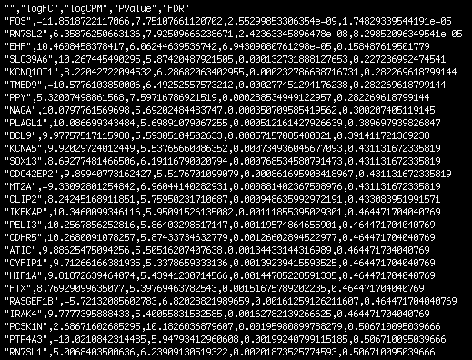
EdgeR
Gene name
Log Fold change
LogCPM
P-value
False discovery rate
Notes:
The output of edgeR is somewhat the same as DESeq2 but the genes that are still significant are smaller for almost every dataset that i’ve tested. Only 2 genes would stay if you use a FDR of 10% as the cutoff

Slide 17
Summary
Info
Data
DESeq2
EdgeR
Monocle2
Comparison

Slide 18
Monocle2
scRNA
Probability distribution of read counts per feature
Negative binomial
R version 3.3.2
Options:
Single-cell trajectory
Clustering
Differential expression
Notes:
Monocle2 is a reworked R script that is used in some articles as a DE tool. This is written for scRNA sequencing data analysis. The expression model is also a negative binomial like all the tools we discussed.
R version of atleast 3.3.2 is needed so a higher and newer R has to be installed in comparison to the other scripts.
Single cell-trajectory is an option in the monocle package, differen kinds of clustering can be performed and ofc differential expression of you single cell data.

Slide 19
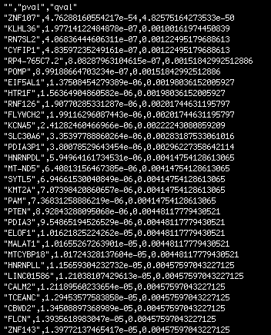
Monocle2
Gene name
No log Fold change
Sorting on p-value
Qvalue lower than 0,10
Filtering (expression on multiple cells)
Notes:
The output of monocle2 is somewhat difficult. This is the filtered data from a sc dataset and only thing you get is the p value and qvalue as valid information. You don’t have the log fold change and the data is sorted on the p value so the lowest p value is first reported. Before the output is given you also filter on qvalue of lower then 0,10. the data can be filtered as in you need a expression in multiple datasets to use it which means if you have a random number of reads in 1 sample but this isn’t in the rest of the samples the reads won’t be used for expression.
DIFFERENCE BETWEEN OTHER TOOLS is that if 1 sample gives a read count they take it to the differential expression. In monocle2 you can decide yourself how many samples must have expressed a certain gene.
The list of genes is huge for monocle 2 which might give some trouble in reporting back the genes

Slide 20
Summary
Info
Data
DESeq2
EdgeR
Monocle2
Comparison

Slide 21
Comparison differential expression
EdgeR
DESeq2
Monocle2
EdgeR
DESeq2
Monocle2
EdgeR
DESeq2
Monocle2
EdgeR
DESeq2
Monocle2
Notes:
These VENN diagram show the pool of detected genes that were overlapped by the 3 tools. Mostly monocle2 gets more different genes in his results in comparison to deseq2 and edgeR
Deseq2 has a lot in common with the monocle2 gene pool which might actually suggest that the deseq might overlap more with monocle2. even though in comparison with deseq2 they might have a lot in common but still monocle would have more different genes.

Slide 22
Personal: monocle2
Pro
More possibilities
Good filter
Used in multiple single cell analysis
Con
No log fold change

Slide 23
Work in progress
Implementing a scRNA analysing tool in a pipeline working with the HPC
Pika 16.08
Debugging
Testing

Slide 24
Any questions?

